Slide 1

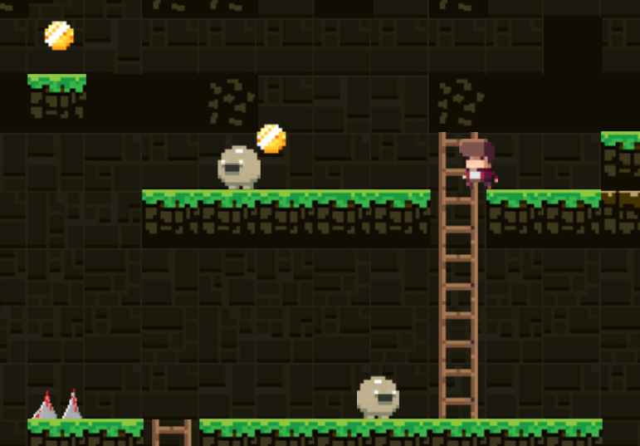


Introduction
Gameplay features:
About the game
Character movement: Can run and jump using the keyboard.
Traps/obstacles: Kill the player instantly.
Start and end points: Go to the exit point to complete the level.
Game scores: Collect coins to have a higher score. (100 scores per coin)
A 2D Platformer game, with the theme of escaping. You're a prisoner and try to find a way to escape.
Player Experience
Under pressure
Core Mechanic
Run, Climb and Jump
Core game loop
Get from A to B by navigating platforms and avoiding traps and enemies

Slide 2
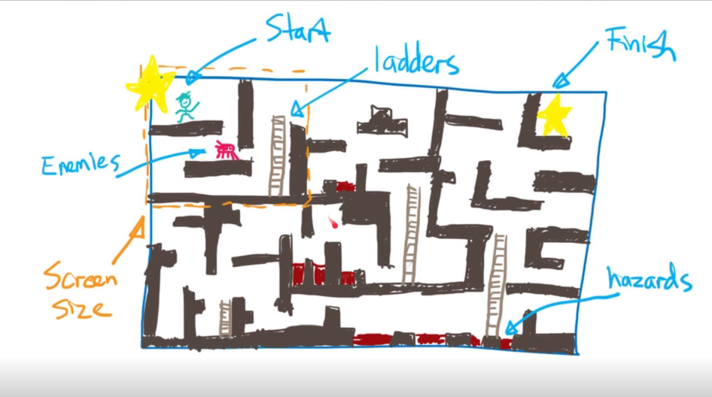


How to play
Collect all the gold coins on the map and go to the Exit sign to complete the round.
During the collection process, there will be obstacles.
The higher level you play, the harder it gets
PLAY
Game Assets
1. Background, Foreground
2. Player, Enemy
3. Exit sign, coins, ladder, spikes

Slide 3

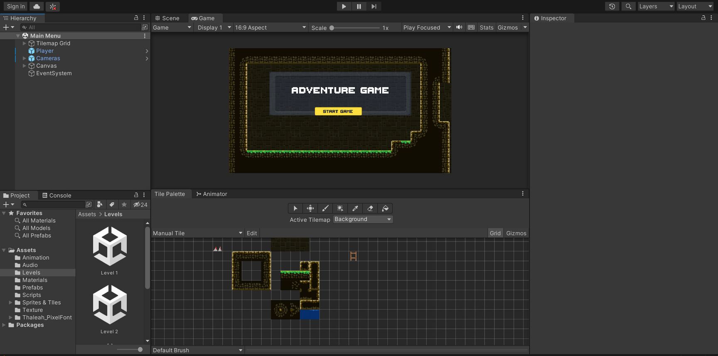
Applied Technique

Slide 4



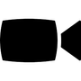



Applied Technique
Setup Scene
Build Player
Setup camera
Build Enemy & Obstacle
Levels
Scores and Lives

Slide 5
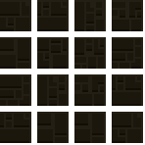
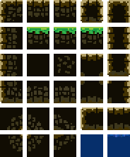
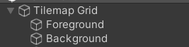
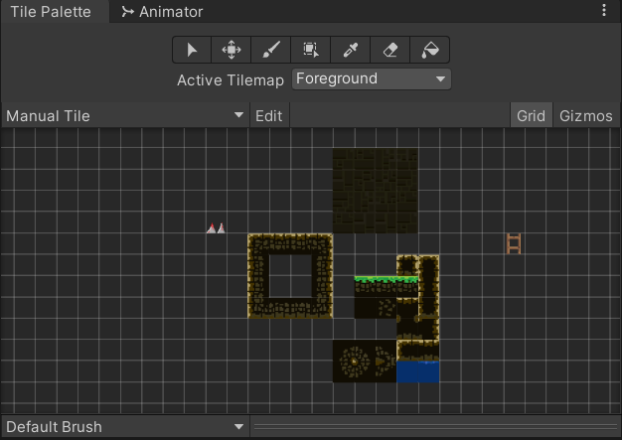
Setup Scene
Background
Foreground
Slice sprite image for Background & Foreground
Create Tilemap for Background & Foreground
Create Tile palette

Slide 6
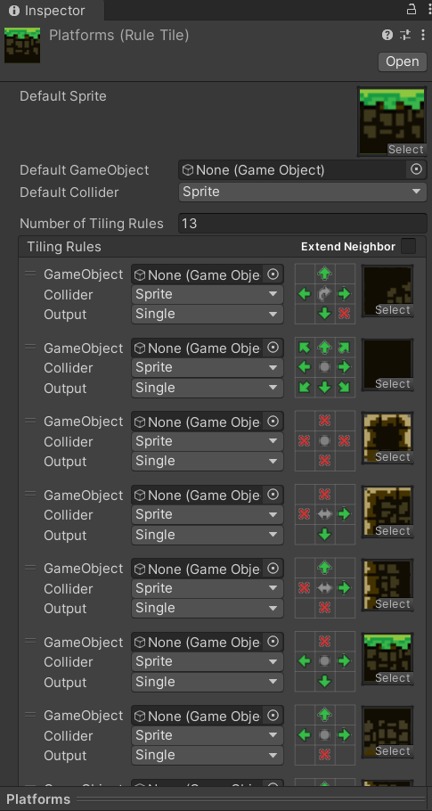
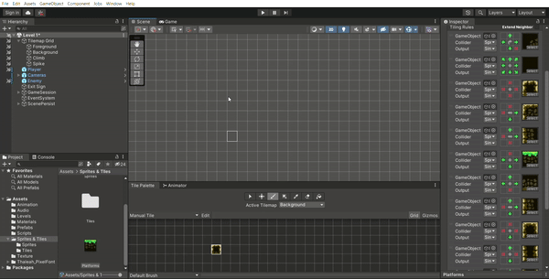
Setup Scene
Create Rule Tile

Slide 7
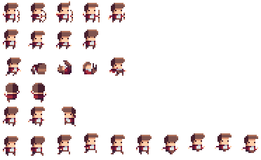
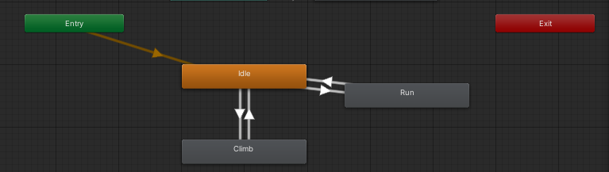
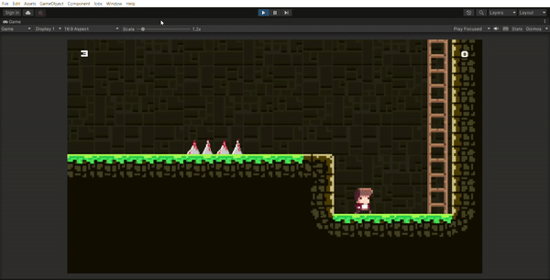
Build Player
Slice Sprite image for Player
Create Animation
Implement movement for Animation (Run, Jump, Climb)

Slide 8
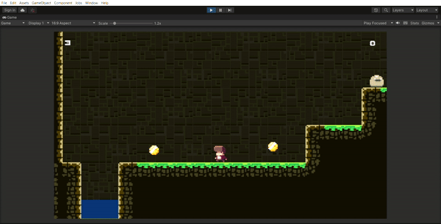
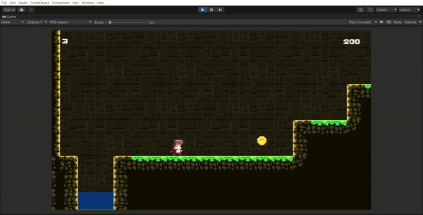
Setup camera using Cinemachine Package
Create Camera follow Player (CinemachineVirtualCamera)
Cinemachine StateDrivenCamera

Slide 9
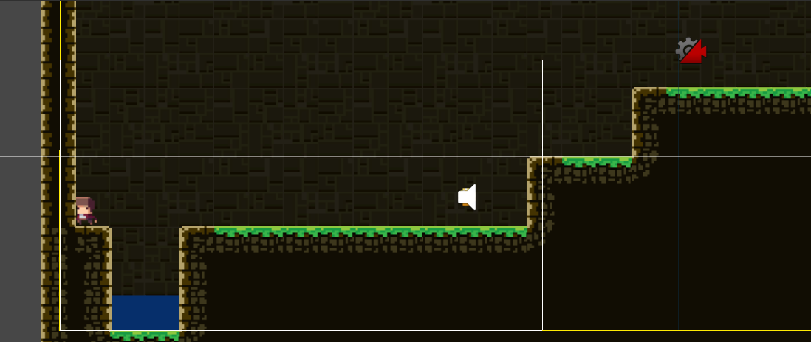
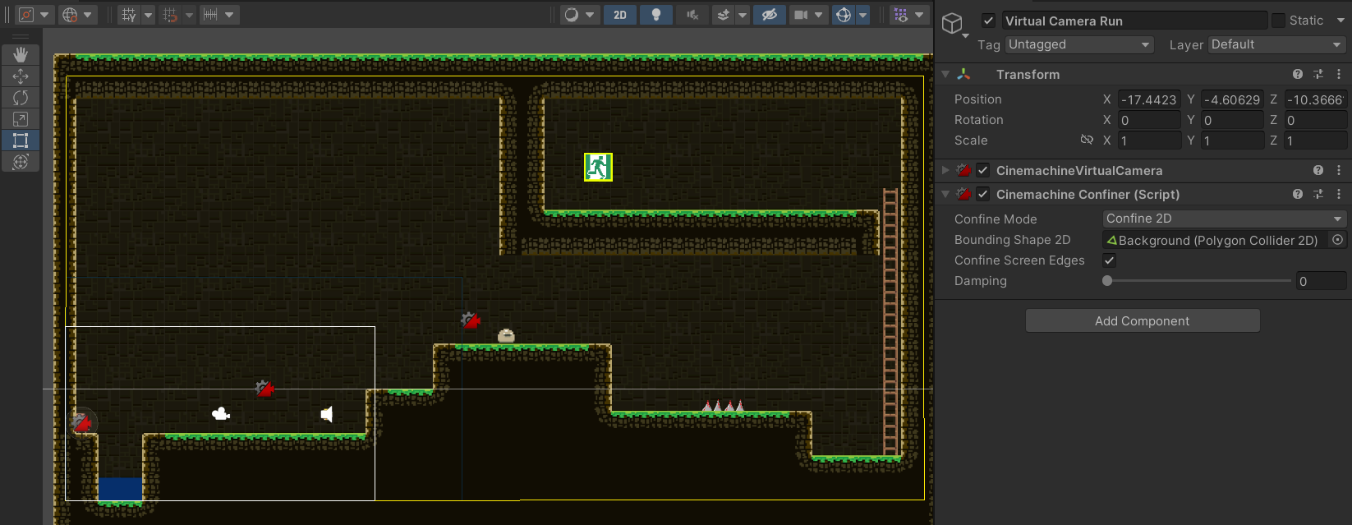
Setup camera using Cinemachine Package
Cinemachine Confinder

Slide 10

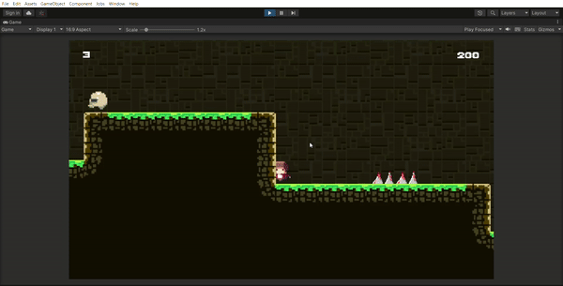
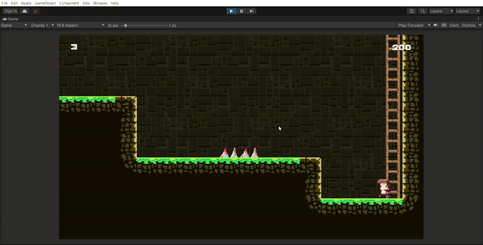
Build Enemy and Obstacle
Slice Sprite image for Enemy
Implement movement for Enemy Animation
Create Obstacle

Slide 11
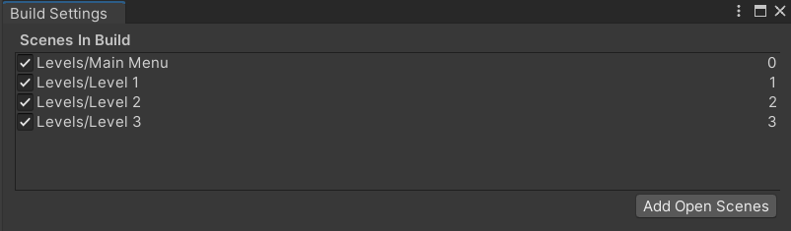
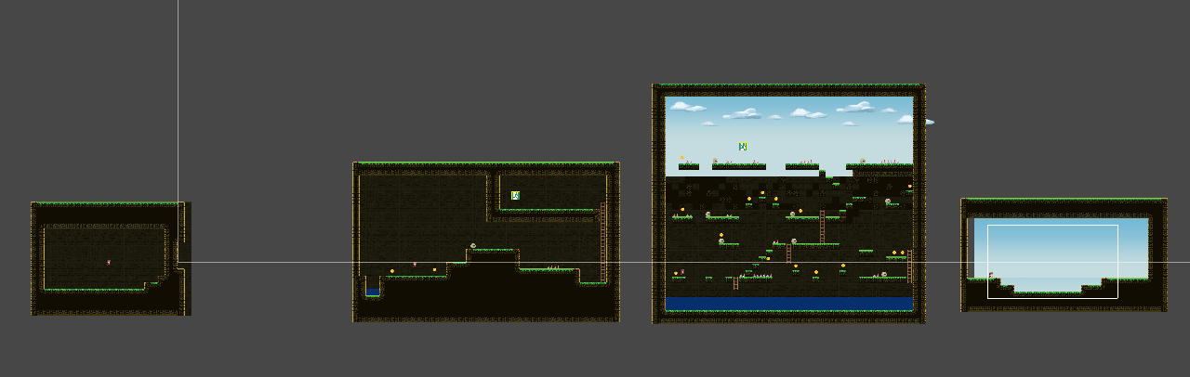
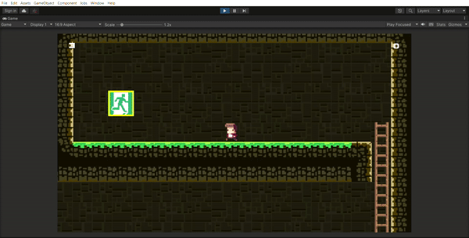
Levels
Level Flow
Level Exit

Slide 12
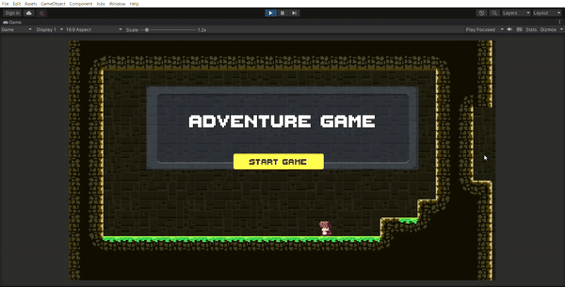
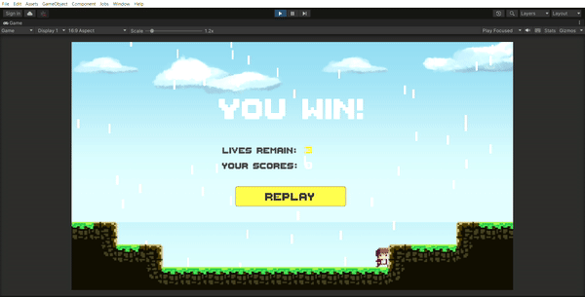
Levels
Scene Start and Finish
Using UI for Text and Button

Slide 13
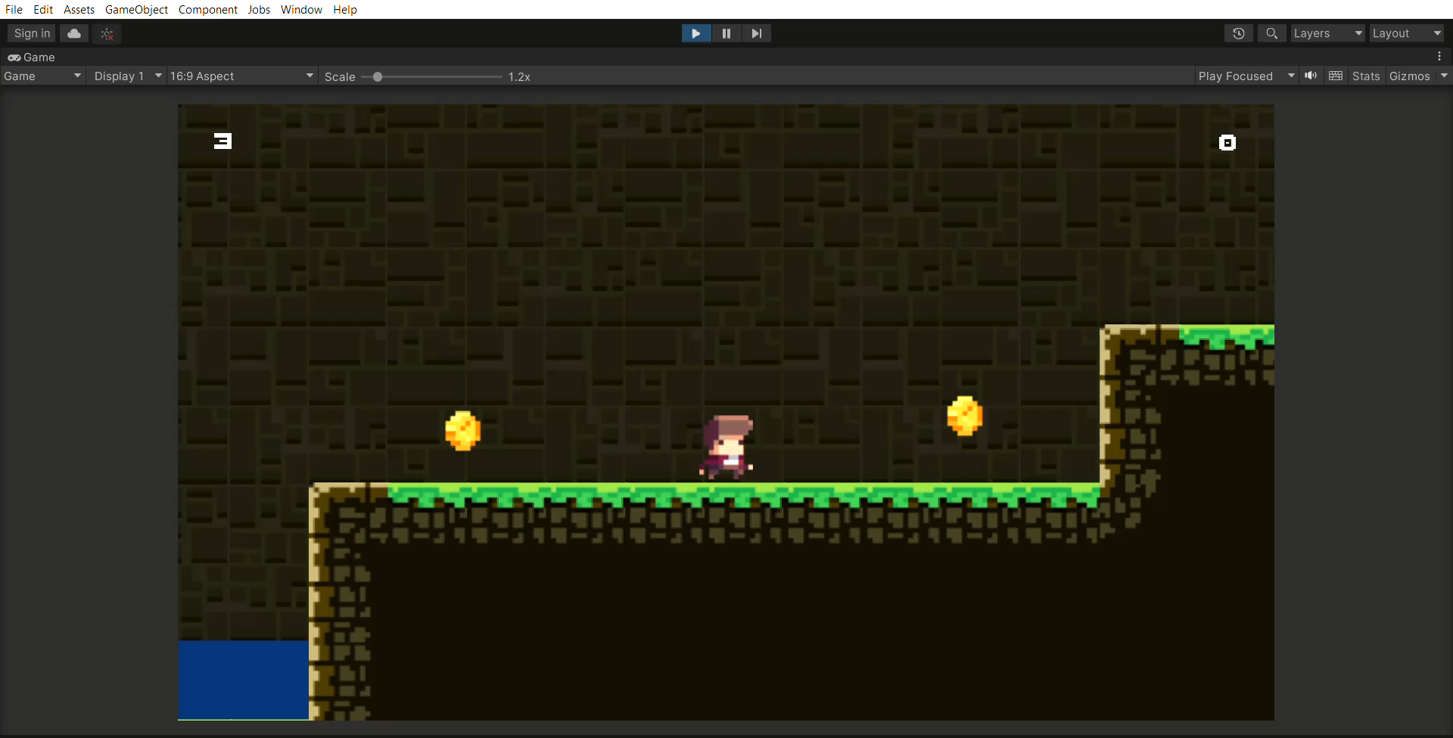
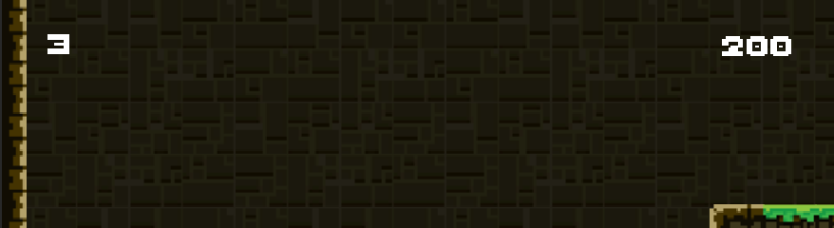
Scores and Lives
Implement collect and SFX Coin
Create HUD for scores and lives

Slide 14

Thank
You

